Slide 1
Heart of the Matter
Delving into Comprehensive Heart Disease Data
Presented by:
Group 4
Gauri Pushkar Kulkarni
Nishant Iyer
Siddhi Ratnaparkhi
Srikar Bollam

Slide 2
Dataset Description
Sr. # | Attribute | Unit | Data Type
1 | Age | In Years | Numeric
2 | Sex | 1,0 | Binary
3 | Chest pain type | 1,2,3,4 | Categorical
4 | Resting blood pressure | In mm Hg | Numeric
5 | Serum cholesterol | In mg/dl | Numeric
6 | Fasting blood sugar | 1,0 > 120 mg/ dl | Binary
7 | Resting electrocardiogram results | 0,1,2 | Categorical
8 | Maximum heart rate achieved | 71 - 202 | Numeric
9 | Exercise induced angina | 0,1 | Binary
10 | Oldpeak = ST | depression | Numeric
11 | The slope od the peak exercise ST segment | 0,1,2 | Categorical
12 | Class | 0,1 | Binary
This heart disease dataset combines 5 previously separate datasets — Cleveland, Hungarian, Switzerland, Long Beach VA, and Statlog (Heart)—into one comprehensive collection.
It contains 1190 instances with 11 common features, making it the largest heart disease dataset available for research.
By analyzing these datasets, it aims to facilitate research on coronary artery disease (CAD) to improve clinical diagnosis and early treatment.
The analysis focuses on predicting the likelihood of heart disease in individuals based on various medical and demographic factors. By identifying patterns and correlations between these factors and heart disease, the analysis aims to assist in the early detection and preventive care of this condition.
Data source: https://www.kaggle.com/datasets/mexwell/heart-disease-dataset/data

Slide 3
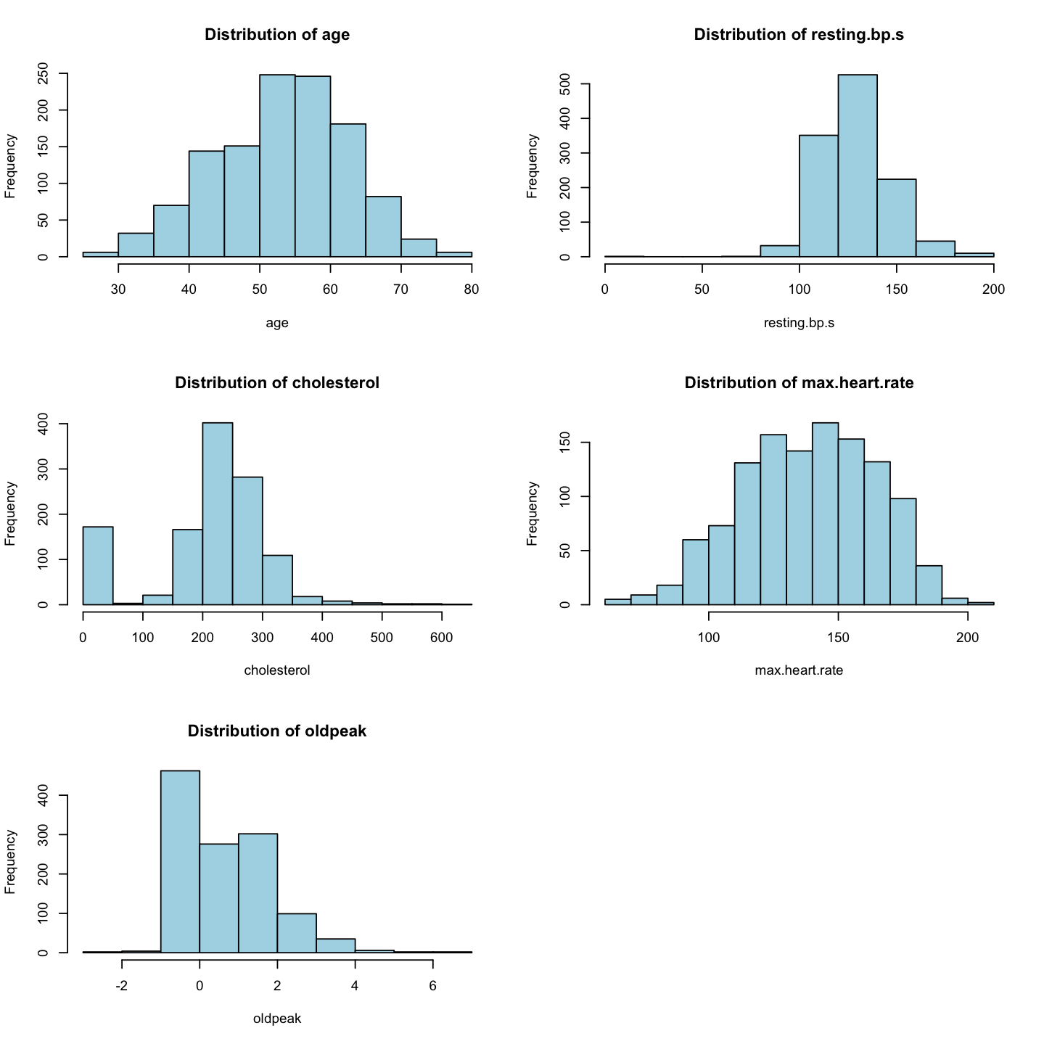
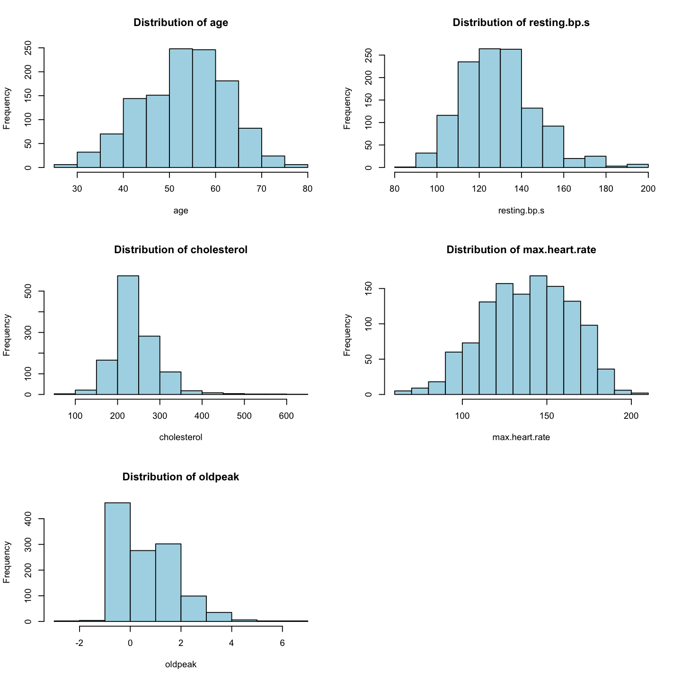
Descriptive Analysis: Histogram Analysis
Before Treating
After Treating
Histograms Analysis:
Age: The data is centrally clustered with a normal distribution pattern, suggesting that the sample is well-balanced across different age groups.
Resting Blood Pressure: Most values are concentrated around the median; however, there is a noticeable spike around 120-140 mmHg.
Cholesterol: The distribution is right-skewed, implying that while the majority of individuals have moderate cholesterol levels, there is a significant number with high cholesterol.
Maximum Heart Rate: Shows a relatively normal distribution with a slight skewness towards higher rates.
Oldpeak: This variable has a right-skew, indicating that most individuals have low oldpeak values, with fewer individuals experiencing higher ST depression levels.

Slide 4
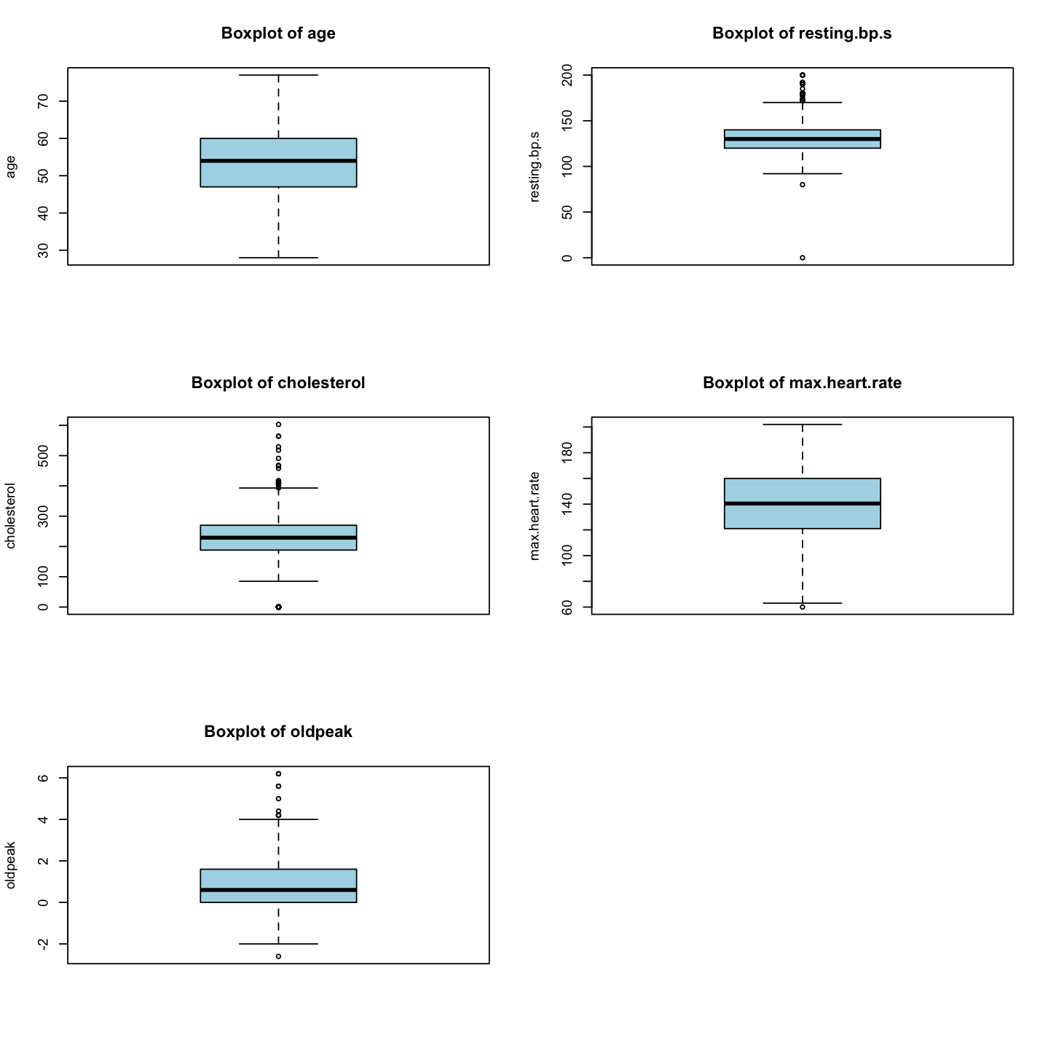
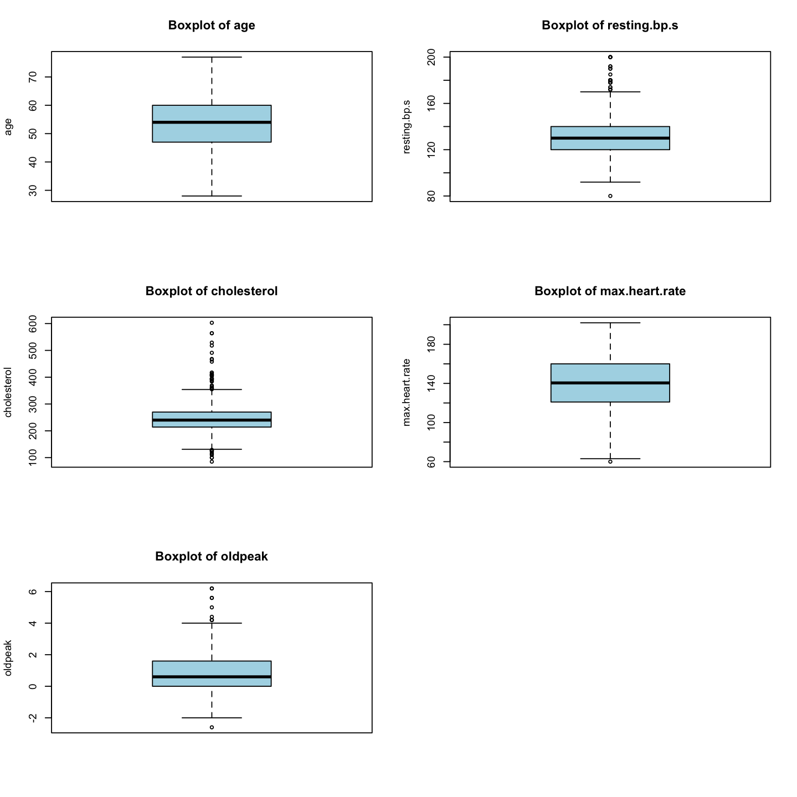
Descriptive Analysis: Boxplots
Before Treating
After Treating
Boxplots Analysis:
Outliers are present in resting blood pressure, cholesterol, and oldpeak. These suggest that certain individuals have values that significantly differ from the general population, which could be indicative of risk factors for heart disease.

Slide 5
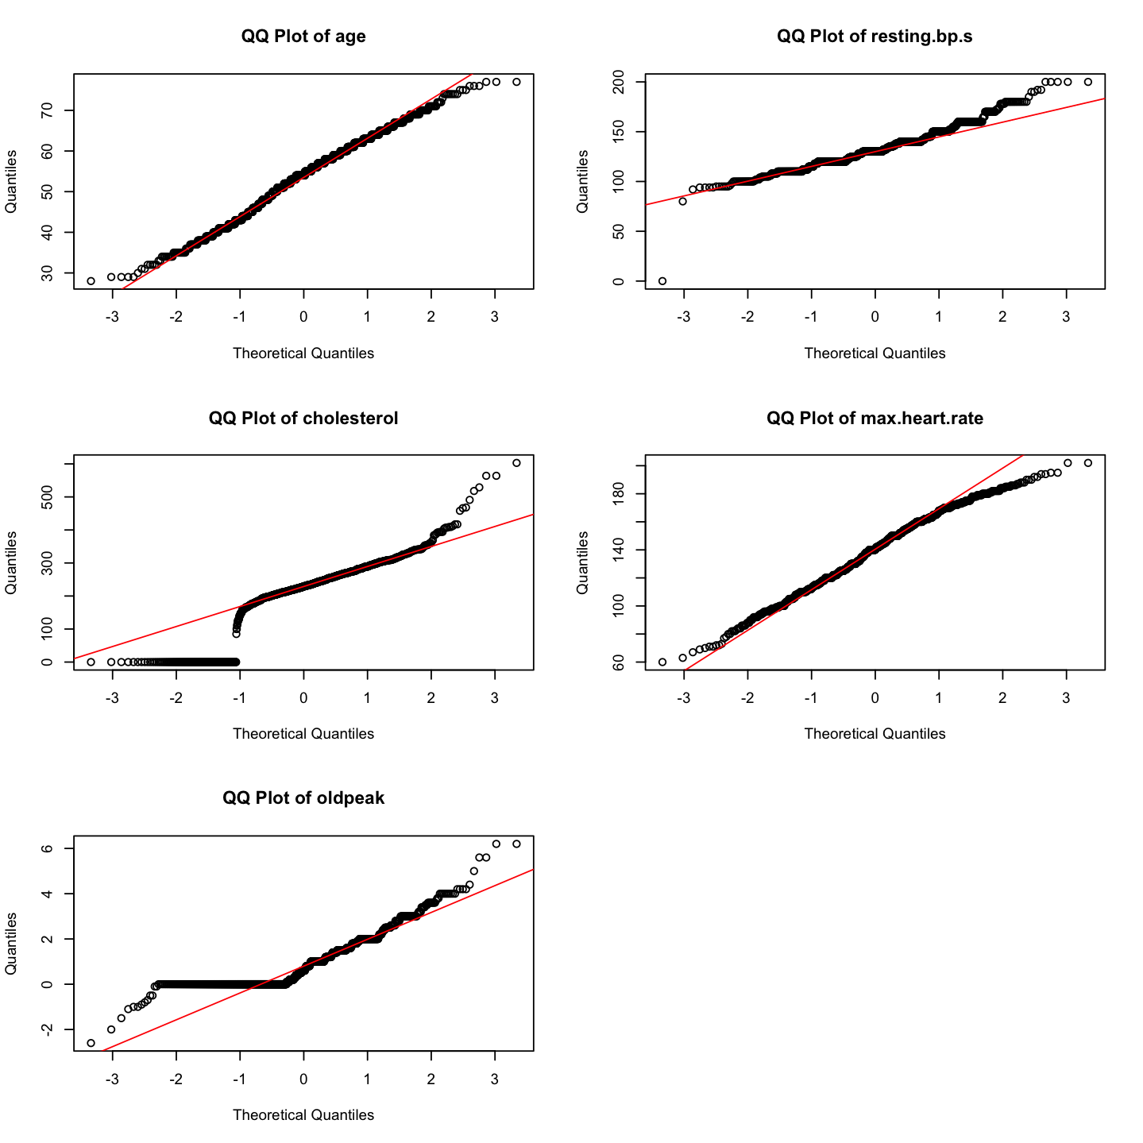
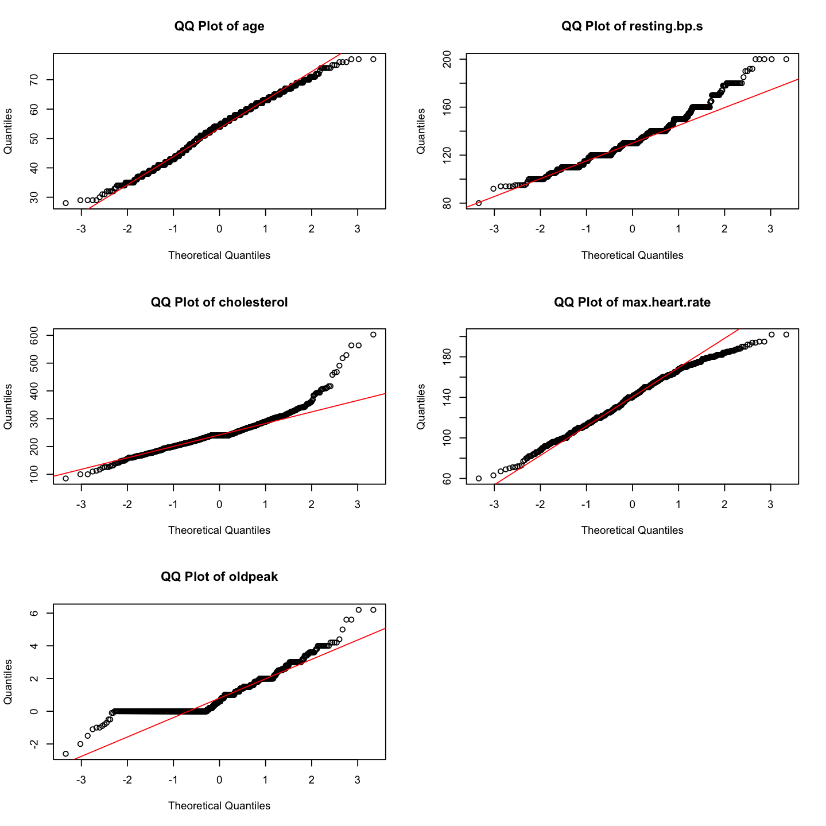
Descriptive Analysis: Q-Q Plots for Normality Check
Before Treating
After Treating
Q-Q Plots for Normality Check:
Age: The data points follow the theoretical line quite closely, especially in the central quantiles, indicating that age is approximately normally distributed.
Cholesterol and Oldpeak: Deviations at the ends suggest heavier tails than a normal distribution, indicative of outliers and skewness, which are especially prominent in the cholesterol variable.

Slide 6
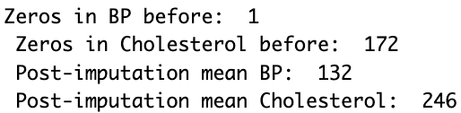
Addressing Data Inaccuracies: Missing or '0' Values Treated with Mean
Observations:
Identified 1 entry with a blood pressure reading of 0, which is clinically impossible.
Detected 172 instances with cholesterol levels marked as 0, which is also not feasible.
Clinical Standards for Reference:
Total Cholesterol:
Desirable: Less than 200 mg/dL
Borderline High: 200–239 mg/dL
High: 240 mg/dL and above
Blood Pressure Range:
Normal: Systolic < 120 mmHg and Diastolic < 80 mmHg
Elevated: Systolic 120–129 mmHg and Diastolic < 80 mmHg
Hypertension Stage 1: Systolic 130–139 mmHg or Diastolic 80–89 mmHg
Hypertension Stage 2: Systolic ≥ 140 mmHg or Diastolic ≥ 90 mmHg
Data Imputation:
Substituted zero values with the mean of the respective attributes.

Slide 7
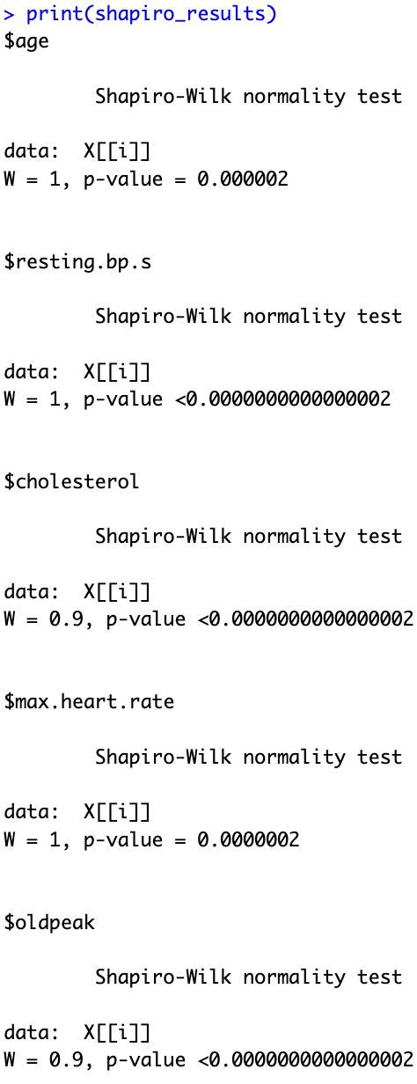
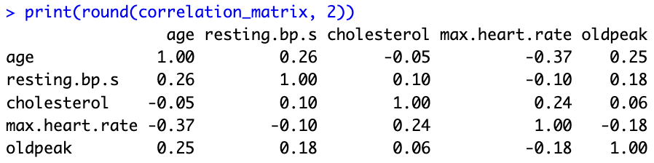
Assumptions Test
Normality Test
The Shapiro-Wilk test is used to determine if a dataset is approximately normally distributed. The test's null hypothesis states that the data is normally distributed.
Age: A very small p-value, indicating that the distribution of age significantly deviates from normality.
Resting Blood Pressure (resting.bp.s): The p-value is essentially zero, suggesting a departure from normality.
Cholesterol: A very small p-value, concluded that the cholesterol levels are not normally distributed.
Maximum Heart Rate (max.heart.rate): The p-value is small, rejecting the normality assumption.
Oldpeak: This variable also shows a tiny p-value, leading to the rejection of normality.
Correlation Matrix
The correlation matrix assesses how strongly pairs of variables are related.
Correlation Coefficients: The values range between -1 and 1. A coefficient close to 1 or -1 implies a strong relationship, while a coefficient close to 0 implies no relationship.
The correlations here are all below 0.4 in absolute value, suggesting only mild associations. For example, age has a moderate negative correlation with max heart rate (-0.37) but only a mild positive correlation with resting bp s (0.26).
Variance Inflation Factor (VIF)
VIF is used to check for multicollinearity among predictor variables in a regression model.
A VIF value of 1 indicates no correlation between a given variable and any other variables. VIF values between 1 and 5 suggest moderate correlation, but not severe enough to require corrective measures. Values above 5 or 10 may indicate problematic multicollinearity.
All VIF values are well below 5, which implies that there is no concerning multicollinearity that would adversely impact a regression model.

Slide 8
Inferential Analysis

Slide 9
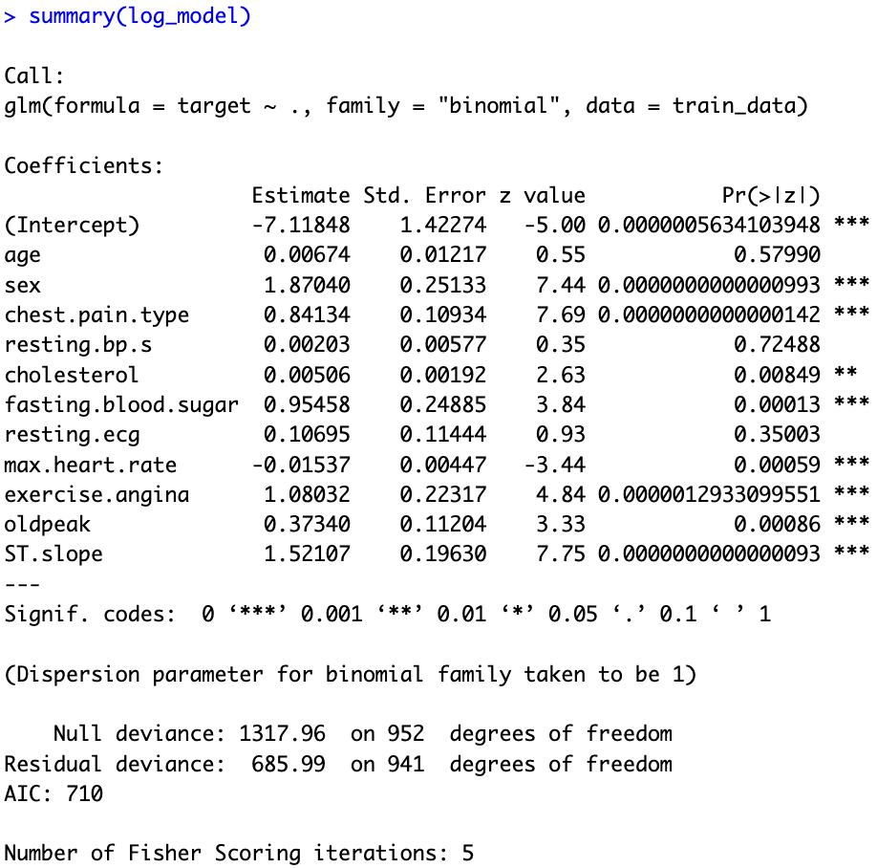
Logistic Regression
Age (Not Significant): The coefficient for age is positive but not statistically significant (p > 0.05). It suggests that age doesn't significantly contribute to the likelihood of heart disease in this model.
Sex (Significant): The coefficient for sex is positive and highly significant (p < 0.001), indicating that being male significantly increases the likelihood of heart disease compared to being female.
Chest Pain Type (Significant): The coefficient for chest pain type is positive and highly significant (p < 0.001), indicating that certain types of chest pain are associated with a higher likelihood of heart disease.
Resting Blood Pressure (Resting BP) (Not Significant): The coefficient for resting blood pressure is positive but not statistically significant (p > 0.05), suggesting that resting blood pressure doesn't significantly affect the likelihood of heart disease.
Serum Cholesterol (Significant): The coefficient for serum cholesterol is positive and statistically significant (p < 0.01), indicating that higher cholesterol levels are associated with a higher likelihood of heart disease.
Fasting Blood Sugar (Significant): The coefficient for fasting blood sugar is positive and highly significant (p < 0.001), suggesting that higher fasting blood sugar levels are associated with a higher likelihood of heart disease.
Resting Electrocardiogram Results (Resting ECG) (Not Significant): The coefficient for resting electrocardiogram results is positive but not statistically significant (p > 0.05), indicating that resting ECG results don't significantly affect the likelihood of heart disease.
Maximum Heart Rate Achieved (Max. Heart Rate) (Significant): The coefficient for maximum heart rate achieved is negative and highly significant (p < 0.001), suggesting that higher maximum heart rates are associated with a lower likelihood of heart disease.
Exercise Induced Angina (Significant): The coefficient for exercise-induced angina is positive and highly significant (p < 0.001), indicating that experiencing angina during exercise significantly increases the likelihood of heart disease.
Oldpeak (ST Depression) (Significant): The coefficient for oldpeak is positive and statistically significant (p < 0.01), suggesting that higher ST depression levels are associated with a higher likelihood of heart disease.
ST Slope (Significant): The coefficient for ST slope is positive and highly significant (p < 0.001), indicating that certain types of ST slope are associated with a higher likelihood of heart disease.

Slide 10
Odds Ratio
Age: For every one unit increase in age, the odds of having heart disease increase by approximately 0.7%. However, this increase is not statistically significant as the confidence interval includes 1.
Sex: The odds of having heart disease are significantly higher for males compared to females. Males are approximately 6.49 times more likely to have heart disease compared to females, with a 95% confidence interval ranging from approximately 3.97 to 10.62.
Chest Pain Type: The odds of having heart disease are approximately 2.32 times higher for individuals with certain chest pain types compared to others. However, specific interpretation of each chest pain type would require further context.
Resting Blood Pressure (Resting BP): There is a negligible effect of resting blood pressure on the odds of having heart disease, as the coefficient is very close to 0 and the confidence interval includes 1.
Serum Cholesterol: For every one unit increase in serum cholesterol, the odds of having heart disease increase by approximately 0.5%.
Fasting Blood Sugar: Having a fasting blood sugar level greater than 120 mg/dl increases the odds of having heart disease by approximately 2.6 times compared to those with lower fasting blood sugar levels.
Resting Electrocardiogram Results (Resting ECG): The type of resting electrocardiogram result does not significantly affect the odds of having heart disease, as the coefficient is close to 0 and the confidence interval includes 1.
Maximum Heart Rate Achieved (Max. Heart Rate): For every one unit decrease in maximum heart rate achieved, the odds of having heart disease decrease by approximately 1.5%.
Exercise Induced Angina: Individuals experiencing exercise-induced angina are approximately 2.95 times more likely to have heart disease compared to those who do not experience it.
Oldpeak (ST Depression): For every one unit increase in ST depression, the odds of having heart disease increase by approximately 45%.
The Slope of the Peak Exercise ST Segment (ST Slope): Individuals with certain types of ST slope are approximately 4.58 times more likely to have heart disease compared to others.
 | B (SE) | OR | Lower CI | Upper CI
Intercept
Age | 0.0067 (0.0122) | 1.0068 | 0.9830 | 1.0311
Sex | 1.8704 (0.2513) | 6.4909 | 3.9661 | 10.6230
Chest Pain Type | 0.8413 (0.1093) | 2.3195 | 1.8720 | 2.8738
Resting BP S | 0.0020 (0.0058) | 1.0020 | 0.9908 | 1.0134
Cholesterol | 0.0051 (0.0019) | 1.0051 | 1.0013 | 1.0089
Fasting Blood Sugar | 0.9546 (0.2489) | 2.5976 | 1.5949 | 4.2306
Resting ECG | 0.1069 (0.1144) | 1.1129 | 0.8893 | 1.3927
Max Heart Rate | -0.0154 (0.0045) | 0.9847 | 0.9761 | 0.9934
Exercise Anigna | 1.080 (0.2232) | 2.9456 | 1.9020 | 4.5619
Oldpeak | 0.3734 (0.1120) | 1.4527 | 1.1663 | 1.8094
ST Slope | 1.5212 (0.1963) | 4.5771 | 3.1153 | 6.7250

Slide 11
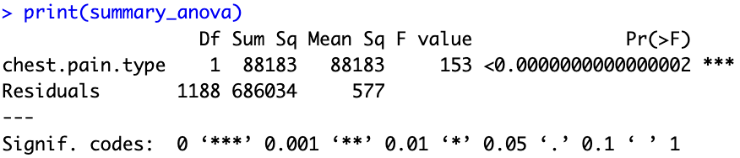
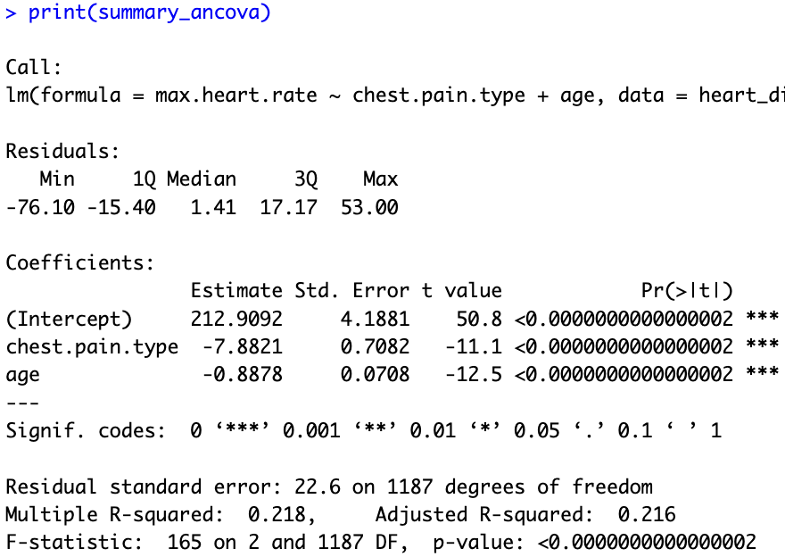
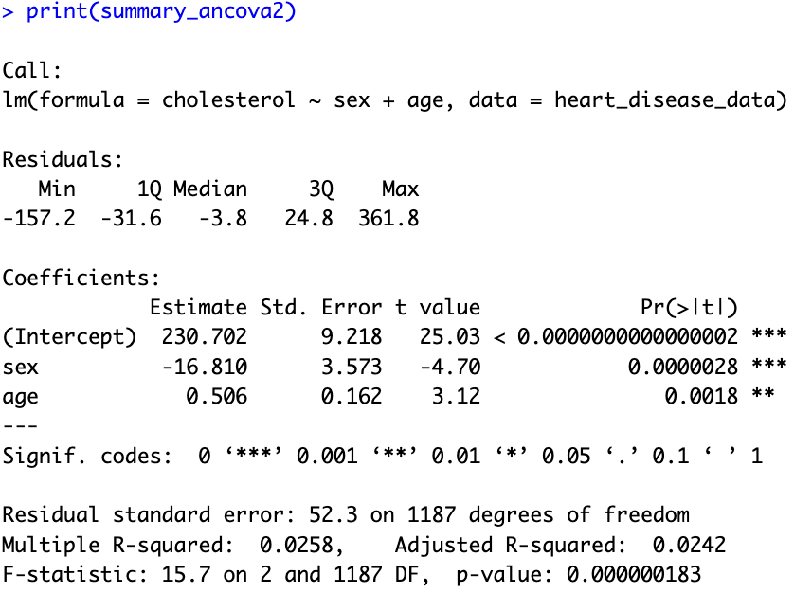
ANOVA
1.⁠ ⁠ANOVA Model for Chest Pain Type vs. Maximum Heart Rate:
The ANOVA model tests the hypothesis that there is a significant difference in the mean maximum heart rate among different levels of chest pain type.
The F-statistic value is 152.7, with an associated p-value less than 2e-16, indicating strong evidence against the null hypothesis. Therefore, we reject the null hypothesis and conclude that there is a significant difference in the mean maximum heart rate among different levels of chest pain type.
2.⁠ ⁠ANCOVA Model for Chest Pain Type vs. Maximum Heart Rate with Age as Covariate:
The ANCOVA model extends the ANOVA model by including age as a covariate.
The coefficients for chest pain type and age are estimated to be -7.8821 and -0.8879, respectively.
Both chest pain type and age are statistically significant predictors of maximum heart rate, as indicated by their respective t-values and p-values.
The adjusted R-squared value is 0.2162, suggesting that about 21.62% of the variability in maximum heart rate can be explained by chest pain type and age together.
The F-statistic value for the overall model is 165, with a p-value less than 2.2e-16, indicating that the model as a whole is statistically significant.
In summary, both the ANOVA and ANCOVA models show that chest pain type is significantly associated with maximum heart rate, even after controlling for age as a covariate. Additionally, age itself is a significant predictor of maximum heart rate.

Slide 12
Final Interpretation

Slide 13
Summary

Slide 14


